Slide 1






Tokyo Olympics 2020 Data Engineering & Analytics Project
End-to-End Azure Data Engineering Project
- By Abhishek Nilekar

Slide 2
Index
Project architecture
Step-wise execution details
Data Integration
Data Transformation
Data Modelling
Data Analytics
Visualization and Insights generation
Key Insights

Slide 3


Project Architecture

Slide 4
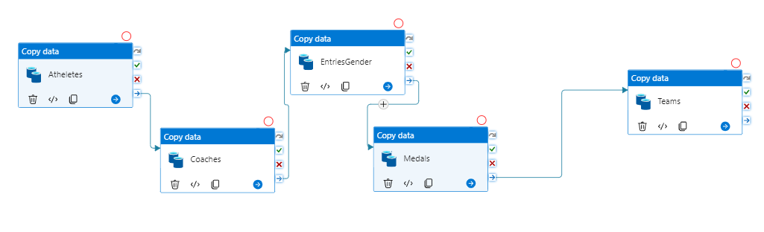
Data Integration using Azure Data Factory
In the first stage of the project, I integrated data from various sources using Azure Data Factory. This tool allowed me to create data-driven workflows for orchestrating and automating data movement and data transformation.

Slide 5
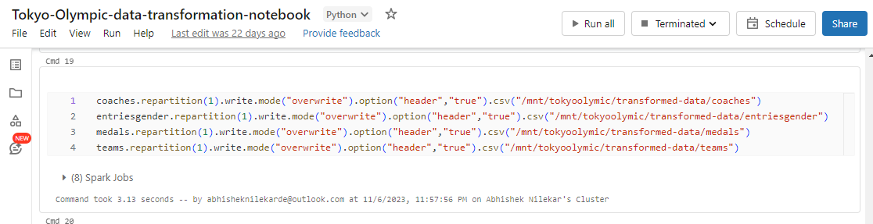
Data Transformation using Azure Databricks
The next step was to transform the data to make it suitable for analysis. I used Azure Databricks for this purpose, which is an Apache Spark-based analytics platform optimized for Azure. It allowed me to transform large volumes of data and make it ready for analysis.

Slide 6
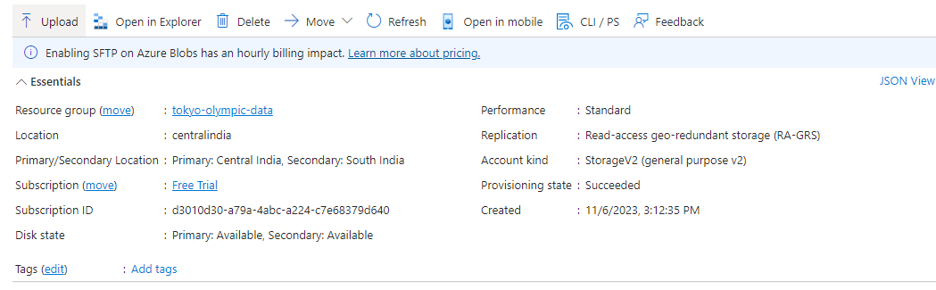
Data Storage using Azure Data Lake Gen 2
After integrating the data, I stored it in a raw data store. For this, I used Azure Data Lake Storage Gen2 which provides secure, scalable, and cost-effective storage.
I stored the transformed data back into Azure Data Lake Storage Gen2. Storing the transformed data separately ensures that the raw data remains untouched and can be used again if needed.

Slide 7
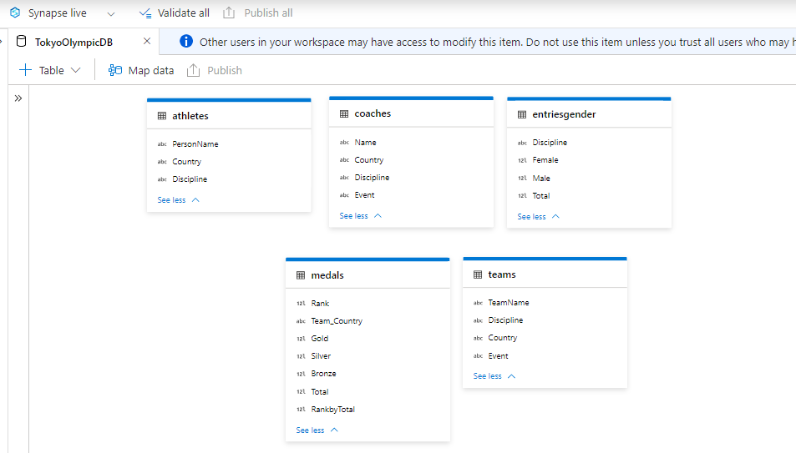
Data Analytics using Azure Synapse Analytics
Finally, I analyzed the data and created a dashboard to visualize it. I used Azure Synapse Analytics, an integrated analytics service, for analyzing the data. For visualization, I used Power BI which helped me create comprehensive dashboards and reports.

Slide 8
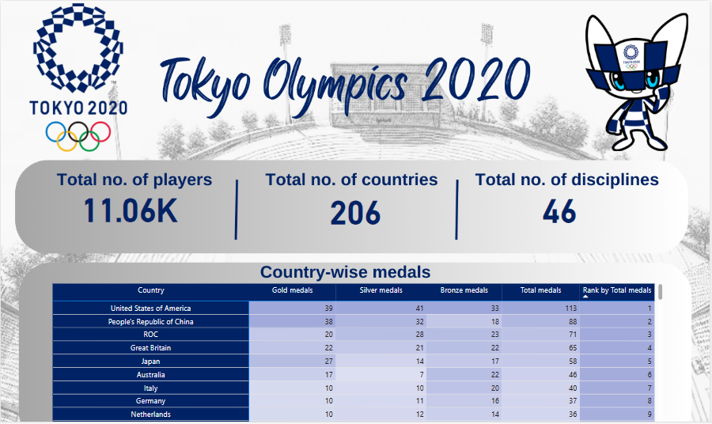
Data Visualization using Power BI
For visualization, I used Power BI which helped me create comprehensive dashboards and reports.

Slide 9
Key Insights generated from Power BI report
More than 10 thousand players participated in Tokyo Olympics 2020, the exact number of participants were 11,060 plyers participated from various countries.
More than 200 countries participated in Tokyo Olympics 2020.
The total number of disciplines in Tokyo Olympics were 46, some of the important disciplines were:
Athletics
Swimming
Badminton
Table Tennis.
USA topped the medal tally with 113 total medals followed by China with 88 medals followed by Great Britain with 71 total medals.
India won total 7 medals and ranked 33 among all the countries

Slide 10
Thank You

